Slide 1
Building a Low Carbon City
Strategies and Actions in Kaohsiung
高雄市政府
Kaohsiung City Government, Taiwan

Slide 2
Outlines
About Kaohsiung
Future prospective
Achievement

Slide 3
About Kaohsiung

Slide 4

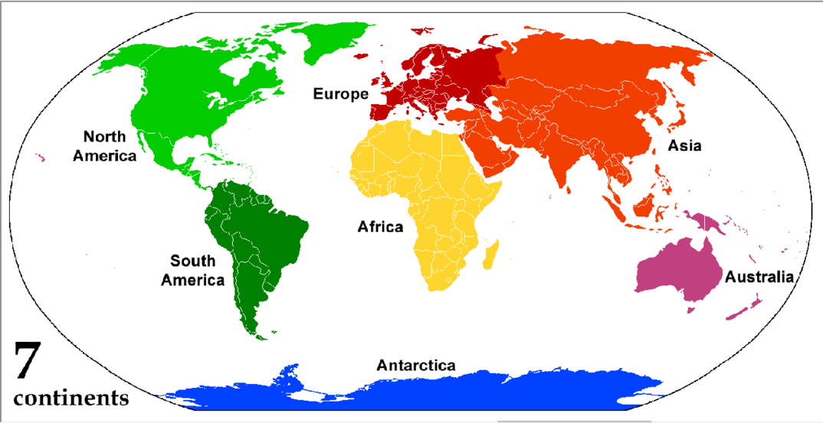
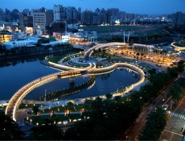
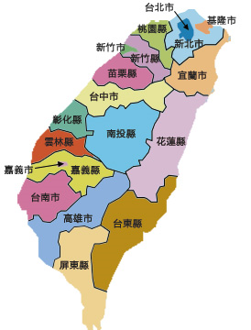
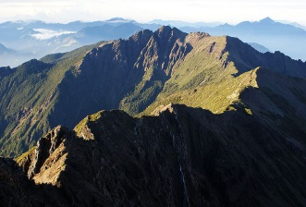

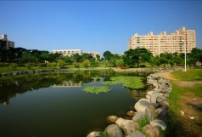

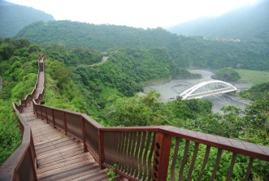
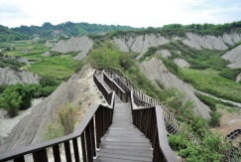
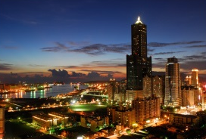
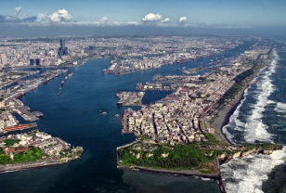
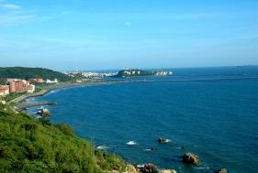
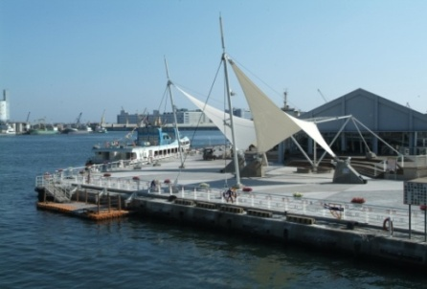
About Kaohsiung
Heart of Love River
Yushan mountain
Wetland Park
Moon World
Asia New Bay Area
Maolin Scenic area
Area： 2,947.61 km²
Population：2.77 million
Density： 946 Pop./km²
Annual average rainfall：1800 mm
Annual average humidity ：70 ~ 81%
Annual average temp.： 18.6 ~ 28.7°C
Sizihwan Bay
Kaohsiung Harbor

Slide 5
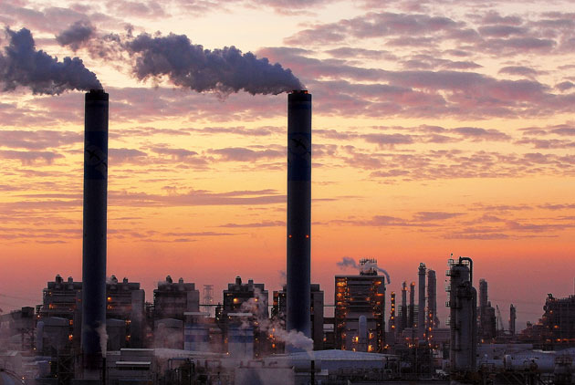
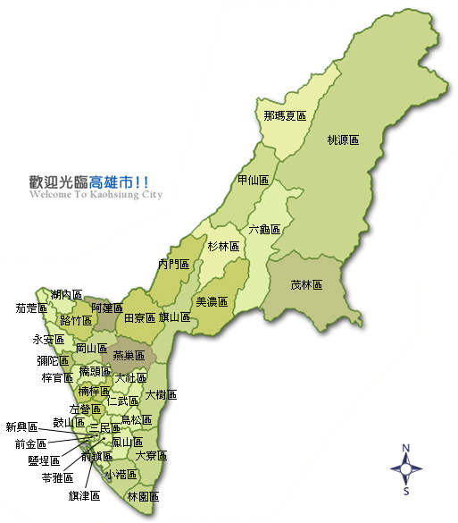
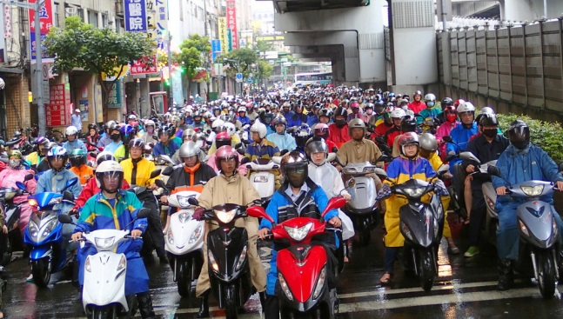
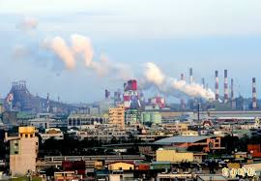
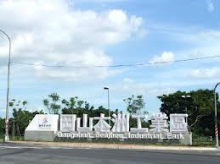
About Kaohsiung
工業區：10大工業區
Motorcycles：2,286,284 vehicles
高雄市每百人有82輛機車，比率為台灣之冠
岡山本洲工業區
南部科學工業園區
永安工業區
楠梓工業區
仁大工業區
鳳山工業區
大發工業園區
臨海工業區
林園工業區
高雄軟體科技園區

Slide 6
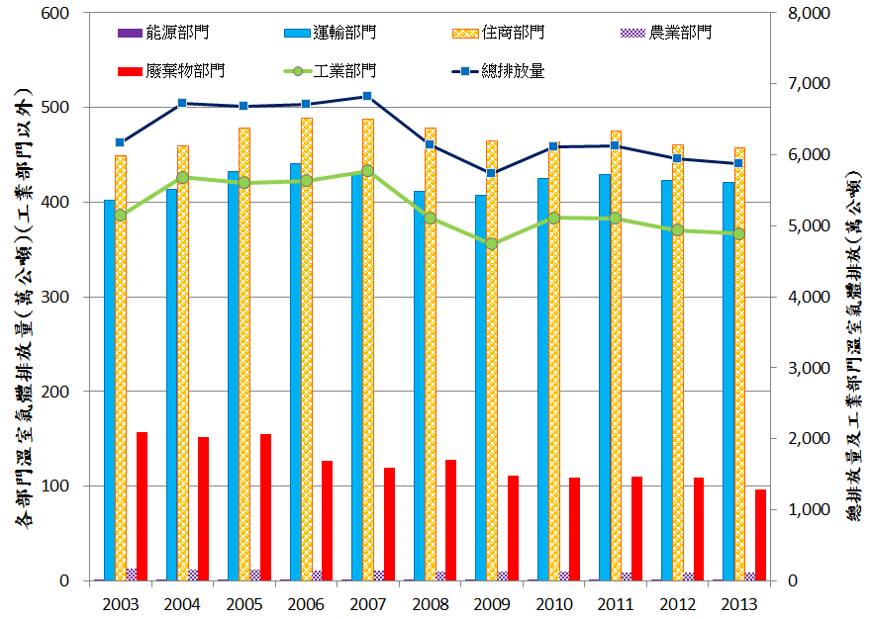
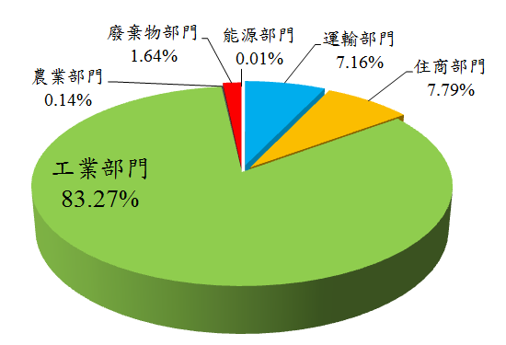
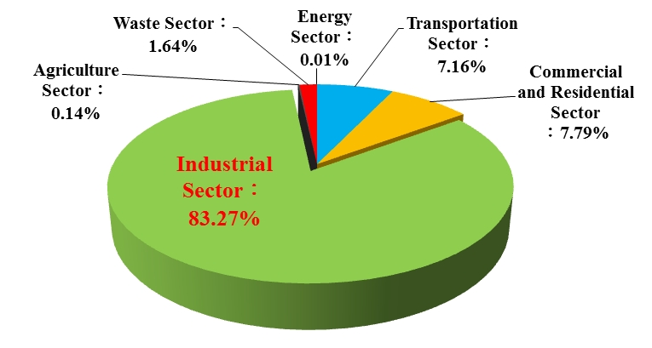
GHG Emission Inventory
GHG Emission in KH
GHG emissions in 2013
Industry sector：83.27%
Start inventory
Total GHG emission in 2013 accounts for about 20% of the country

Slide 7

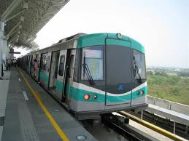

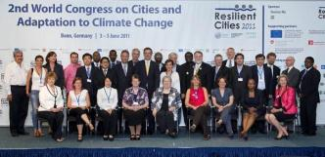






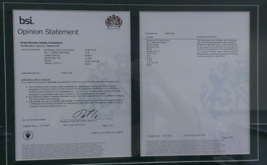
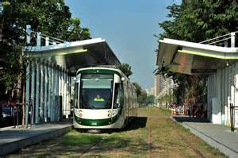


Promote international exchanges progress
Become a member of ICLEI
Join COP11 meeting
Start GHG inventory
2006
2005
Expected to reach greenhouse gas reduction target(20%)
2007
Start joining ICLEI meeting
Join ICLEI-CCP Project
2008
International diplomatic partner with NGO and students
2010
Set up the GHG emission goal
Complete City’s greenhouse gases external verification (2012)
2011
-11.6%
2012
2016-2020
2014
2015
-12.6%
Kaohsiung Municipal Environmental Autonomous Regulations
ICLEI K Capacity Center
Green Building autonomous regulations
Industrial sectors submit self-management plans
Verify on 2012
Notes:
高雄市於2005年參與COP11會議並開始啟動溫室氣體盤查，
2006年成為國內第一個ICLEI會員，2007年開始參與ICLEI會議、加入ICLEI-CCP專案，
2008年與NGO及學生成為國際外交夥伴，高雄捷運正式營運啟用，雙路線全長42.7公里，共設置39站。
2010年訂定溫室氣體減量目標，建立公共自行車租賃制度達成高雄大眾運輸工具的完整性。
透過溫室氣體減量策略及節能減碳目標之執行之下，2011年本市溫室氣體減量11.6%，並開始CDP填報作業及簽訂地方生物多樣性行動備忘錄(LAB MOU) ，成為LAB第51個會員城市；同年10月23日會後與13個城市公民團體簽署國際低碳運輸聯盟宣言(EcoMobility Alliance Declaration)，是台灣第一個也是唯一簽署宣言的城市。
2012年本市為推動生態城市，達到減碳減災目標以成為環熱帶圈城市典範，於6月18制定高雄市綠建築自治條例，溫室氣體持續減量12.6%。6月ICLEI假巴西舉行之「ICLEI世界大會」，經ICLEI配對擔任馬爾地夫首都馬列市(Male’City, )之導師代表；9月成立ICLEI能力辦公室 (ICLEI KCC) 。本市同時開始ICLEI-Carbonn填報作業，並於同年成為UCLG(United Cities and Local Governments)及WMCCC(World Mayors Council on Climate Change)之會員。
2014年本市完成2012年之城市溫室氣體外部查證。
2015年訂定高雄巿環境自治條例，同年參與市長聯盟(Compact of Mayors)揭露本市溫室氣體排放量，而正在建設中的高雄輕軌預計8月開始營運。
未來2016-2020年預計推動工業部門事業單位提送自主管理計畫，並預計達成溫室氣體減量目標(20%) 。

Slide 8
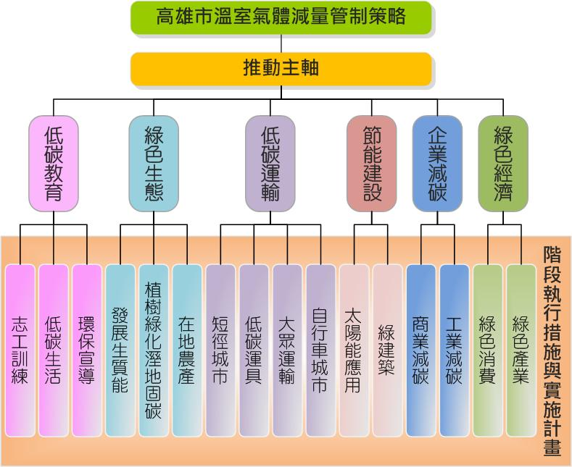
Kaohsiung plans to promote policies and reduction targets
Taiwan’s Goal
National carbon dioxide emissions reduction, in 2020 emissions back to 2005, back to 2000 emissions in 2025.
GHG
Achieve the Goal
Energy Saving/ Carbon Reduction
Goal : Reduce by 20% in 2020
Kaohsiung ‘s Goal
Strategy development for
institution and school
1. Electricity conservation target
Lower electricity usage than pervious year by 1%
Lower EUI into baseline by 2015
Stop increasing electricity use
2. Oil savings target
Set up a goal for each unit to implement oil reduction
by 1% in comparison with pervious year as principle
3. Water conservation goal
Set up a goal for each unit to implement water reduction
by 2% in comparison with pervious year as principle
4.Paperless goal
Decrease 40% as a goal by 2015

Slide 9
Achievement

Slide 10
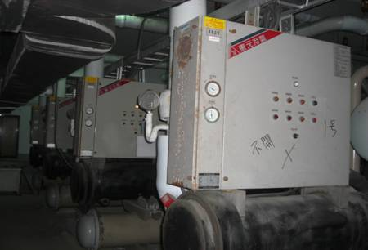
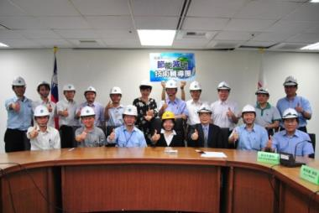
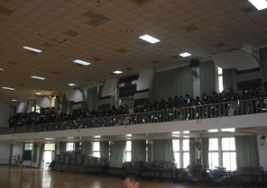
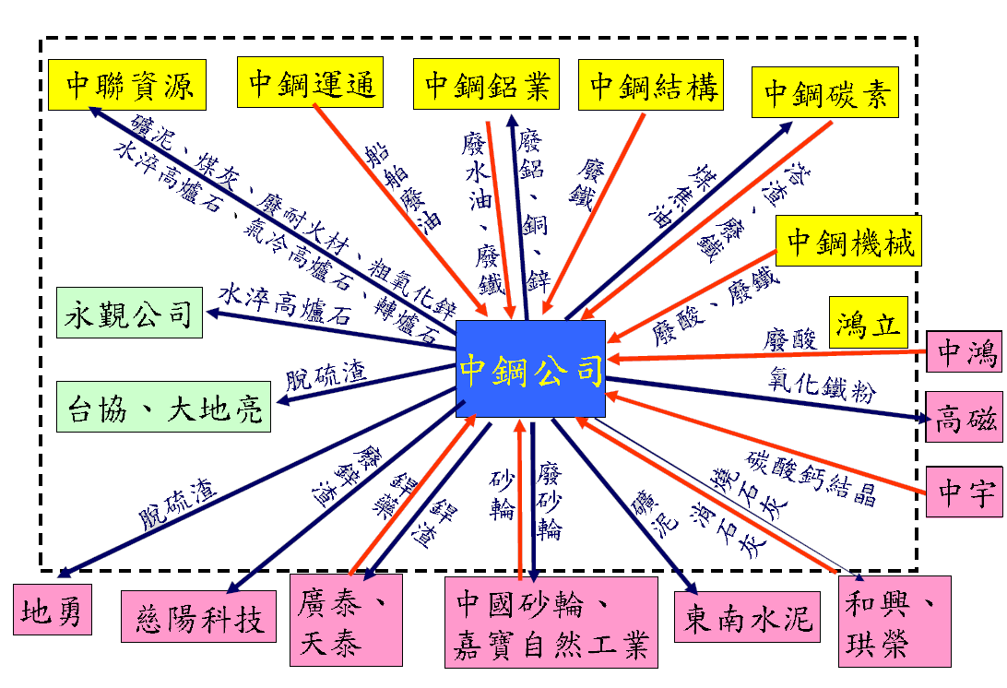
Green economy ＆ Corporate and carbon reduction
Green economy：Enterprises channel into ESCO and processes counseling
Institutions
Air Conditioning System
Investigation
Industrial process energy-saving technology
Heating system
Illustration meeting
Counseling
Electricity system
＝
Green Building / Architectural Design
Documentation
Kaohsiung carbon reduction counseling group
Corporate of carbon reduction :
Integration of energy and resource
臨海工業區 - 區域資源整合現況
Equivalent to reduction emission amount of 434,000 tons CO2e from the burning of fossil fuel
The steam in 2014 has sold 189 tons
＝

Slide 11
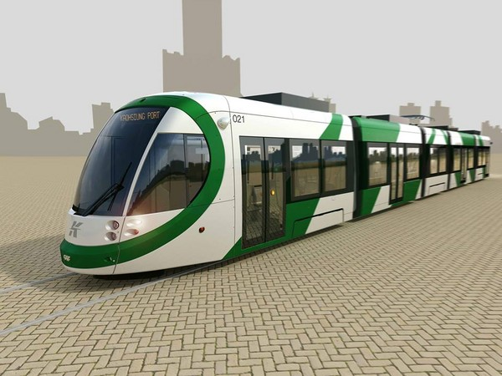
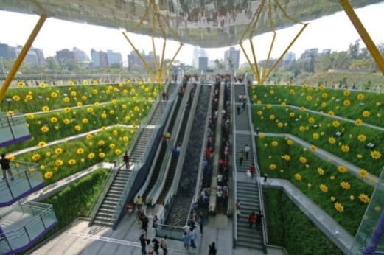
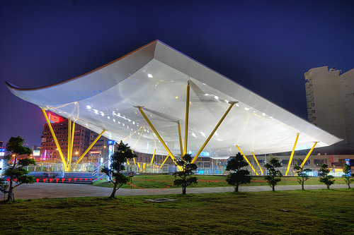
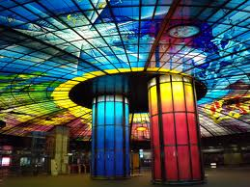
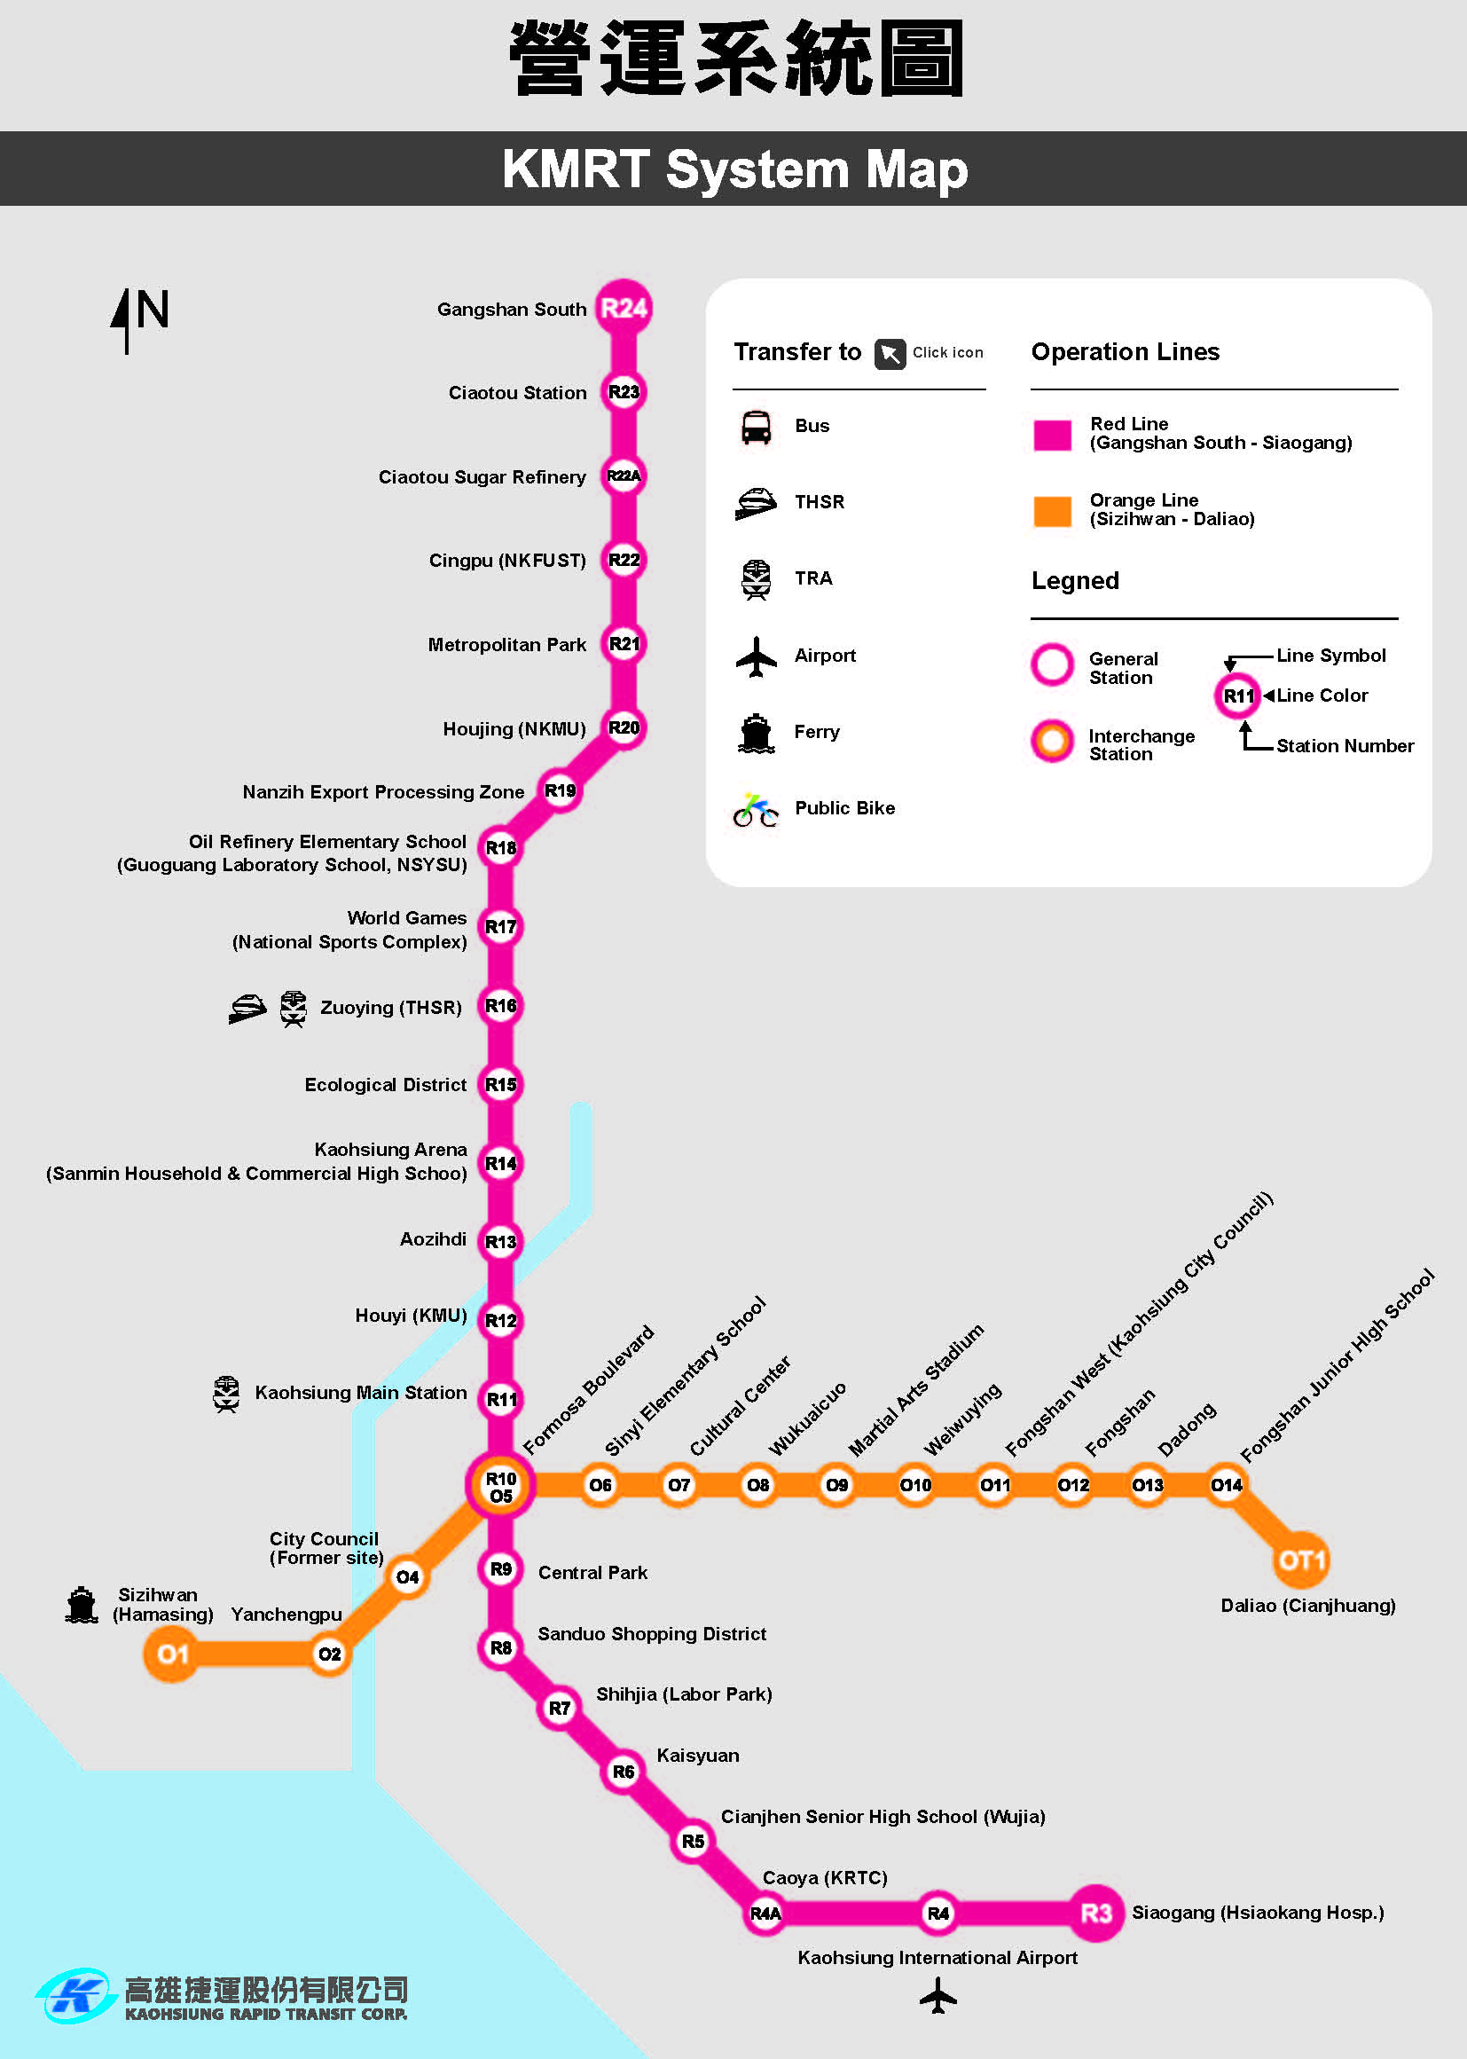
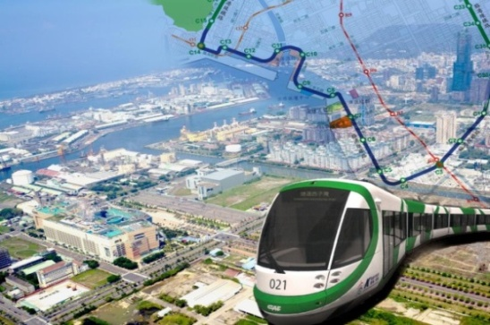
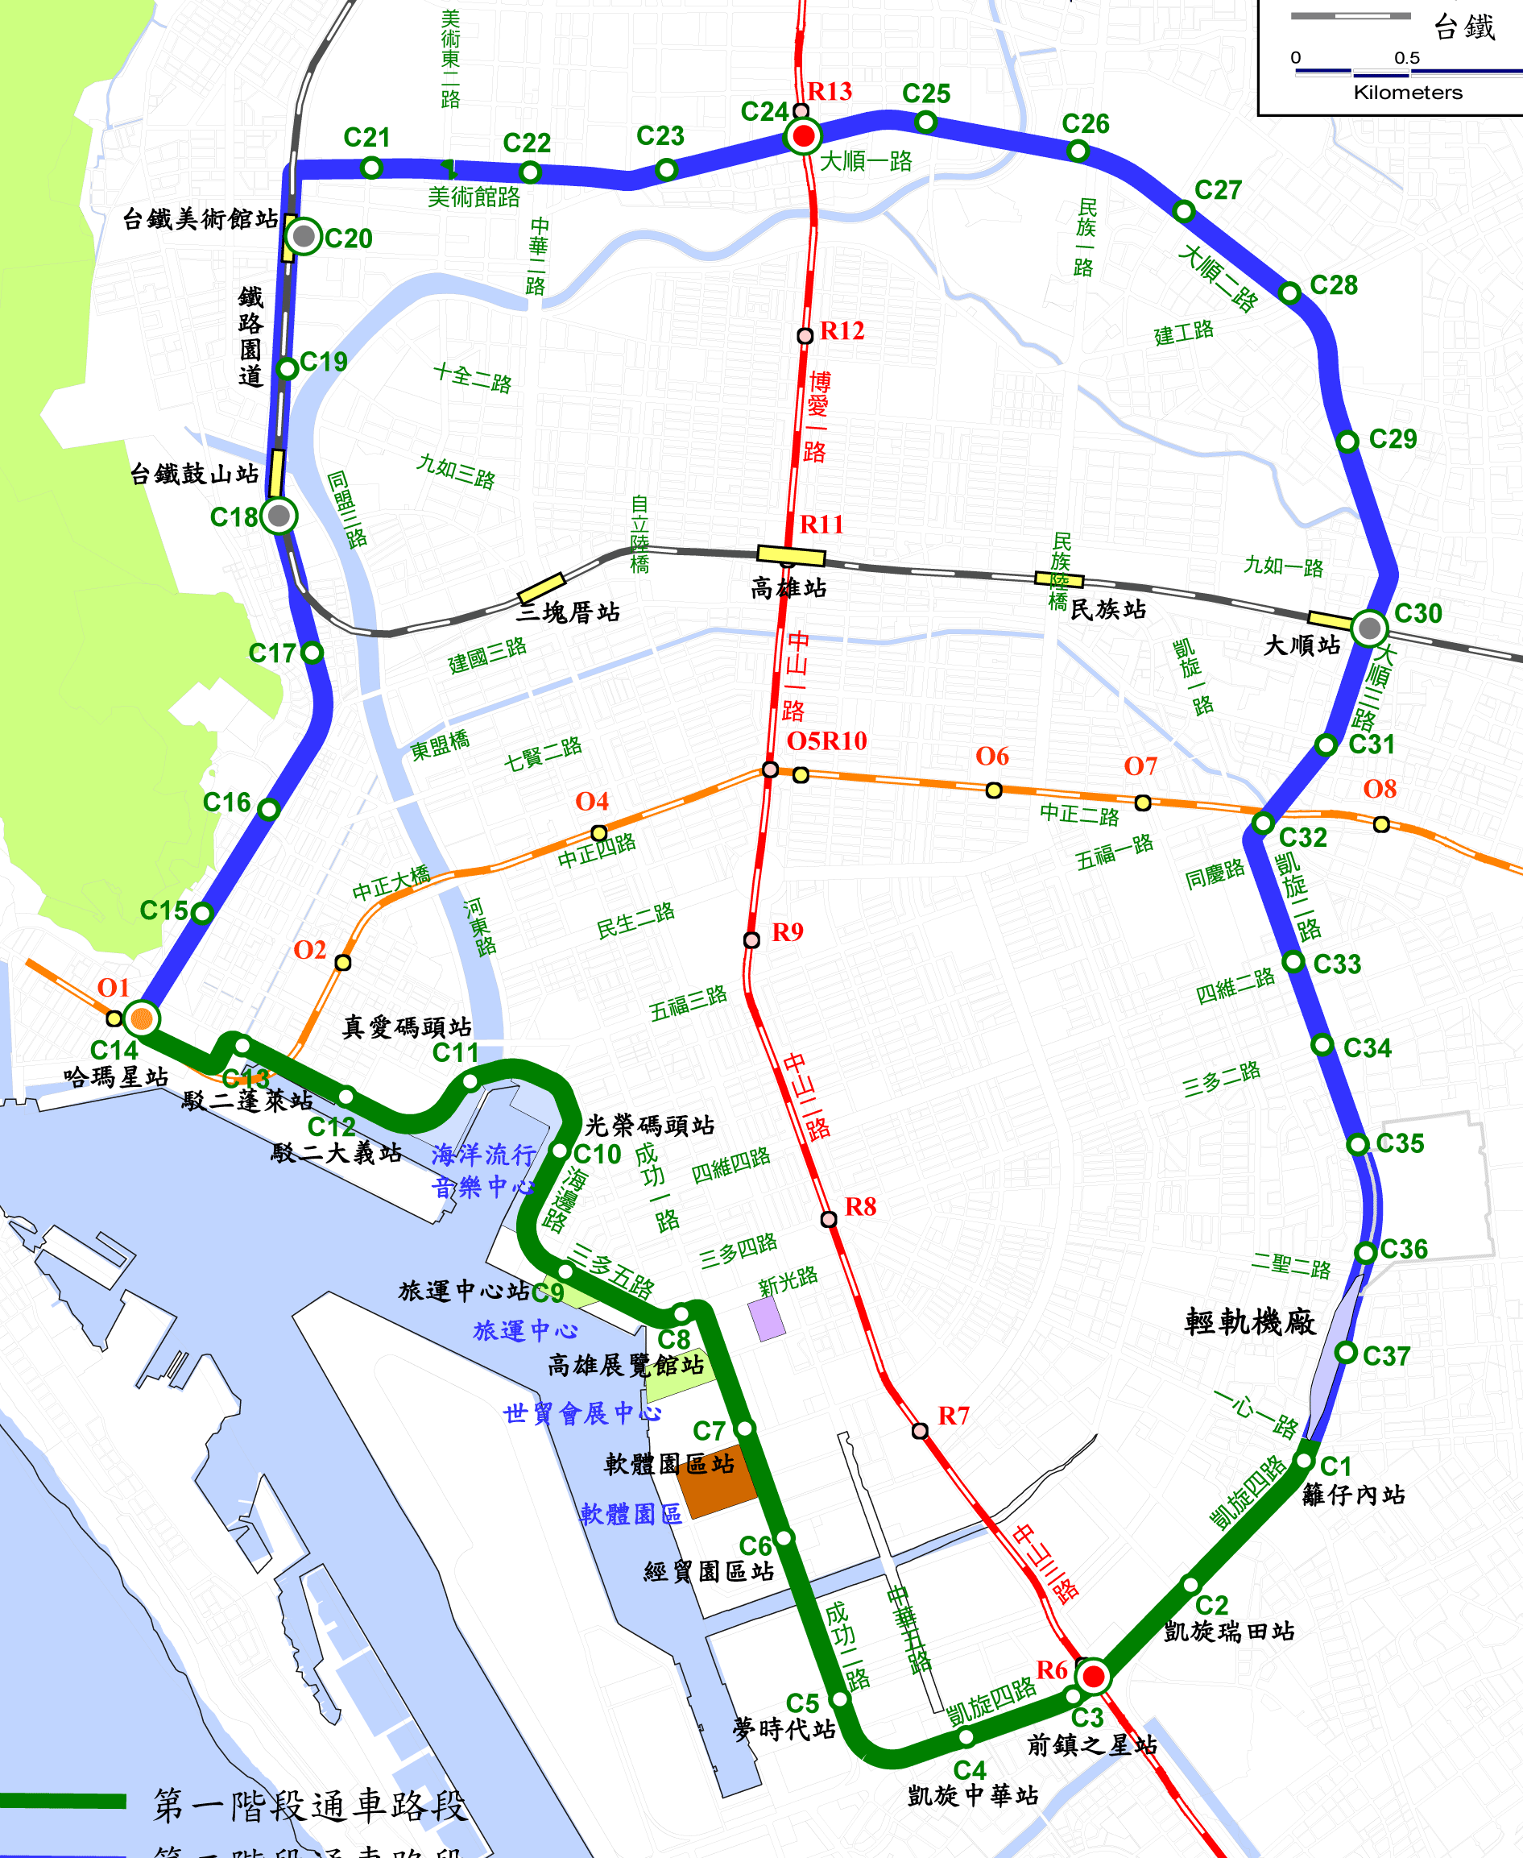
Low carbon transportation- Light Rail
MRT
Light Rail
Dual route length :42.7 km，39 stops
Light rail is under construction ,
total length is 22.1 km。

Slide 12



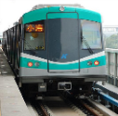
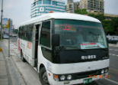


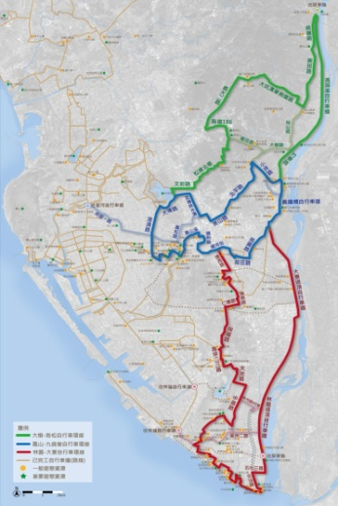
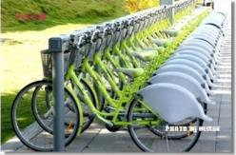
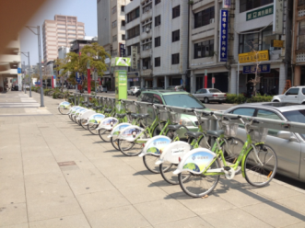
The Development of Kaohsiung Bikeway and Public Bike Rental System
Low rate of using public transportation
MRT
BUS
?
X
O
Before
Last Mile Service
After
Public Bike
  Avg. rentals：7,536 times per day
4.8 times
growth
Cycle way of over 755 km long has been built.

Slide 13

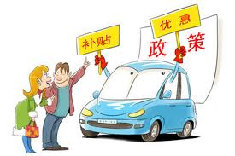
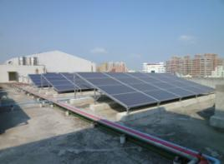
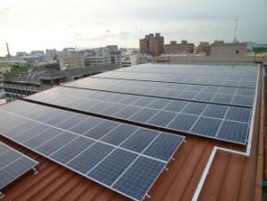
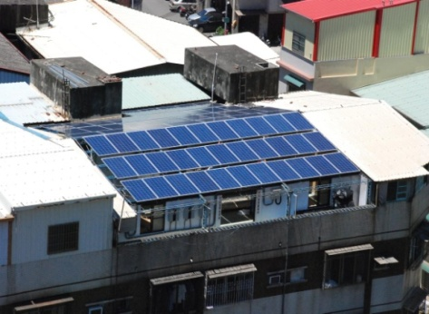
Low carbon results – Energy saving building
Regulation setting
Green Building autonomous regulations
Method of Photovoltaic Facilities setting on the roof of Green Building
Subsidy
Photovoltaic Facilities setting on the roof of Kaohsiung’s public building implementation plan
Plan implementation of Photovoltaic Facilities setting on the roof of Green Building
Subsidy for old building renovation
Regulation of Kaohsiung city ‘s Green Building certification
Notes:
13

Slide 14
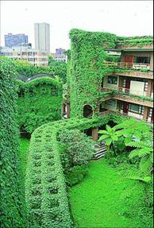
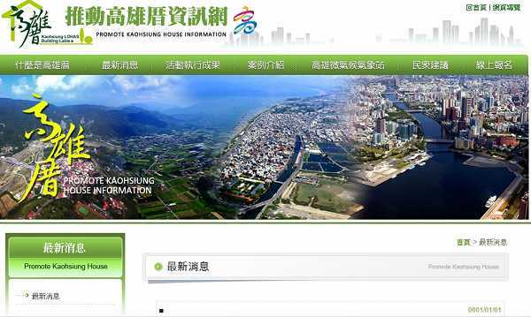
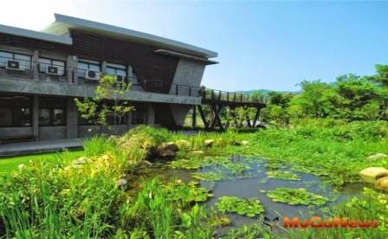
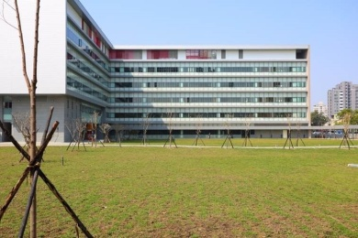
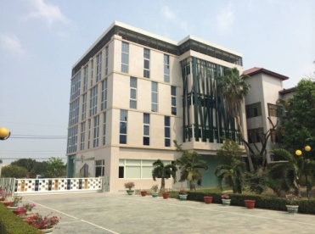
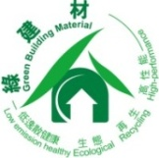





Low carbon results – Energy saving building
Kaohsiung House’s Design and Guidelines
Living Truf
Design of Green Building roof
Environmental
Sustainability
Local Features
Live Health
External shading devices
Appliance to environmental construction materials
Input local materials and technique
Human-based common use design
Creativity of courtyard
Create effective ventilation openings
Appreciated space using mechanism
Design of area imagination
Notes:
14

Slide 15






Green ecological- Wetland Conservation
Kaohsiung has successfully created 19 wetland parks with total area about 2,114 hectare.
Nanzihsiian River Wetland
Jiading Wetland
Daguei Lake Wetland
Yongan Salt Pan Wetland
Wetland of the National Kaohsiung University
Banping Lake Wetland
Yuanjhong Harbor Wetland
Shetsai inpi wetlands
Jhouzai Wetland
Ben-he village Detention pond
Naweibe Wetland
Old Railroad Bridge Wetland
Jhongdou Wetlands
Niaosong Wetland
Love River Wetland
Yanshuei Estuary Wetland
Fongshan Reservoir Wetland
Linyuan Manmade Wetland
15

Slide 16
The LAB Progress Kaohsiung has Achieved
Kaohsiung signed LAB memorandum in 2011
LAB Pioneer Project
2012.12
Done
Step 1: Production of a biodiversity report
To be Done
Step 2: The Mayor signs The Durban Commitment
2013.4
Done
Step 3: A Local Biodiversity Strategies and Action Plan (LBSAP) is formulated
Step 4: The LBSAP goes through the official
process to gain council approval
2013.6
Done
2014-16
Execution
Step 5: 3 biodiversity projects in the LBSAP, are implemented on the ground

Slide 17

The LAB Progress Kaohsiung has Achieved
3-year span LBSAP undergoing (2014-2016)
2013
2014
2015 ～16
6/27
12/23
June
LBSAP framework approved by Kaohsiung Sustainable Development Committee.
Detailed work ,
Performance indicator and
Revised point of short-term action plan are worked out and approved by Committee.
1st revised point. The framework will be shown in next few slides.
2nd revised point. The Report of achievements during 2013 – 2014 has done
Review and make adjustments on detailed work annually
Revised periodically ( adaptive management )

Slide 18





Ecological Map of Kaohsiung
APP
Highlights of Biodiversity
Appliance of Biodiversity Database Exchange Platform
Linking between Land use and Biodiversity
Cross-border Communication and Citizen Participation in Conservation
Job Creation and Community Empowerment

Slide 19
Future prospective

Slide 20
Kaohsiung planning to promote policies working and reduction targets
City vision: to create a new eco-sustainable green city, expect the future to reach the blue sky, clean water, green space, low-carbon, sustainable living environment
Low carbon
life
Green
ecological
Low
carbon
transportation
Energy
saving
building
Corporate and
carbon
reduction
Green
economy
_{To} reach the target via policy implementation
GHG emission
reduction target
GHG reduction targets：CO2 emissions with 2005 as the base year, to reach 20% reduction in 2020.

Slide 21








Kaohsiung City: Plan promote policy –
Self-management for industrial sector
Map out autonomous regulations
Control Object
First：
Electricity、 Steel 、 Petroleum refining 、 Cement 、 Semiconductor 、 Thin film transistor liquid crystal display .
Scope1 GHG annual emission >1,000,000 tons CO2e。
Second：
Scope1 GHG annual emission>25000 tonCO₂e。
Inventory / register
Voluntary and counseling
Mandatory declaration
2009
2013
2015
Reduction
Voluntary , responsibility
Self-managed reduction
自願暨輔導
GHG self-management plan– Procedure
First year
Second year
Third year
Submit「GHG self-management plan」
Review the emission goal via relevant authorities
Offset the insufficient amount

Slide 22




Low-carbon future of Kaohsiung city
Carry on the reduction plan to reach the goal
Kaohsiung
Apply for becoming a part of COM, Strive for ICLEI city representatives qualifications ,to join COP 21
Promote the Photovoltaic renewable energy
Notes:
SERVICE AUDITS ...
© SGS Société Générale de Surveillance SA - All rights reserved - May 2003
22

Slide 23




Low-Carbon Action → campus modification
Starting rain stored tank action
Setting up rain stored tank
Campus Modification
KEPB
Schools
Education
Demonstration
Before
Progress
After

Slide 24
Thanks for your participation

